Slide 1
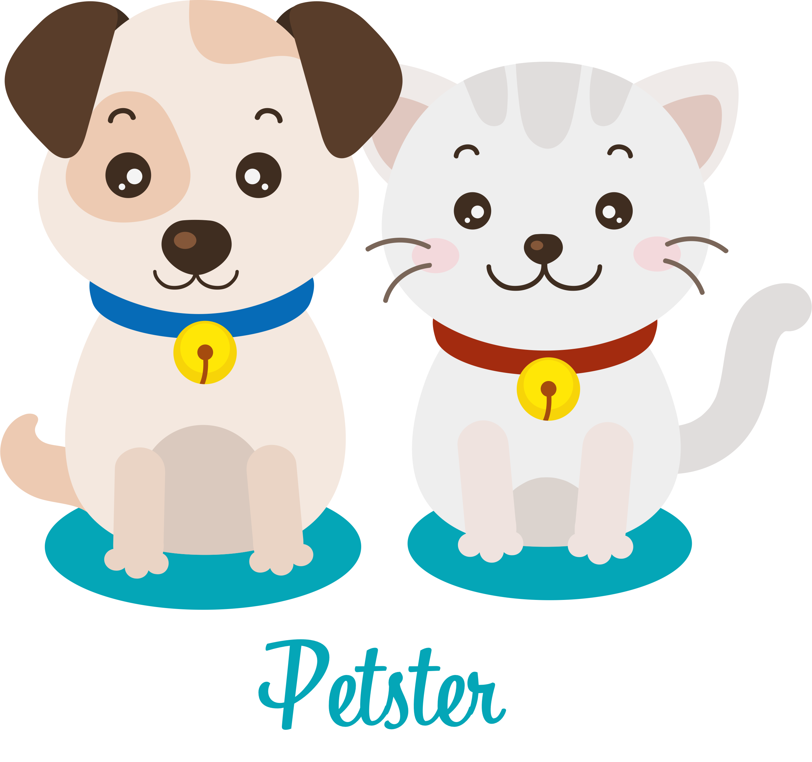
PetSter
An essential app for all animal lovers
Team – Innovative Exploreres

Slide 2

Problem Statement
As per a study, 1 in 3 pets will become lost at some point during their life*
As pet owners, we are constantly worried about losing a pet whenever we take it outdoors
As animal lovers, sometimes we come across an injured animal on a road, and we are clueless how to respond
Missing common platform to connect experts with new pet owners
* Source: https://www.petfinder.com/dogs/lost-and-found-dogs/why-microchip/

Slide 3

Welcome, Petster
Provides essential services to your pets like tagging a pet & identifying a lost pet
Used by animal lovers to report pet emergencies like accidents on road, a lost pet, etc
Used by certified emergency responders to cater to reported emergencies faster and better
unified platform for animal lovers and pet owners so that they could help each other and share ideas

Slide 4
Technologies
React Native – For creating screens, navigation etc.
Flask Python Server – For serving API requests from App, connecting to database etc.
MongoDB database – For storing user specific data
Android Emulator - For testing app end-to-end

Slide 5
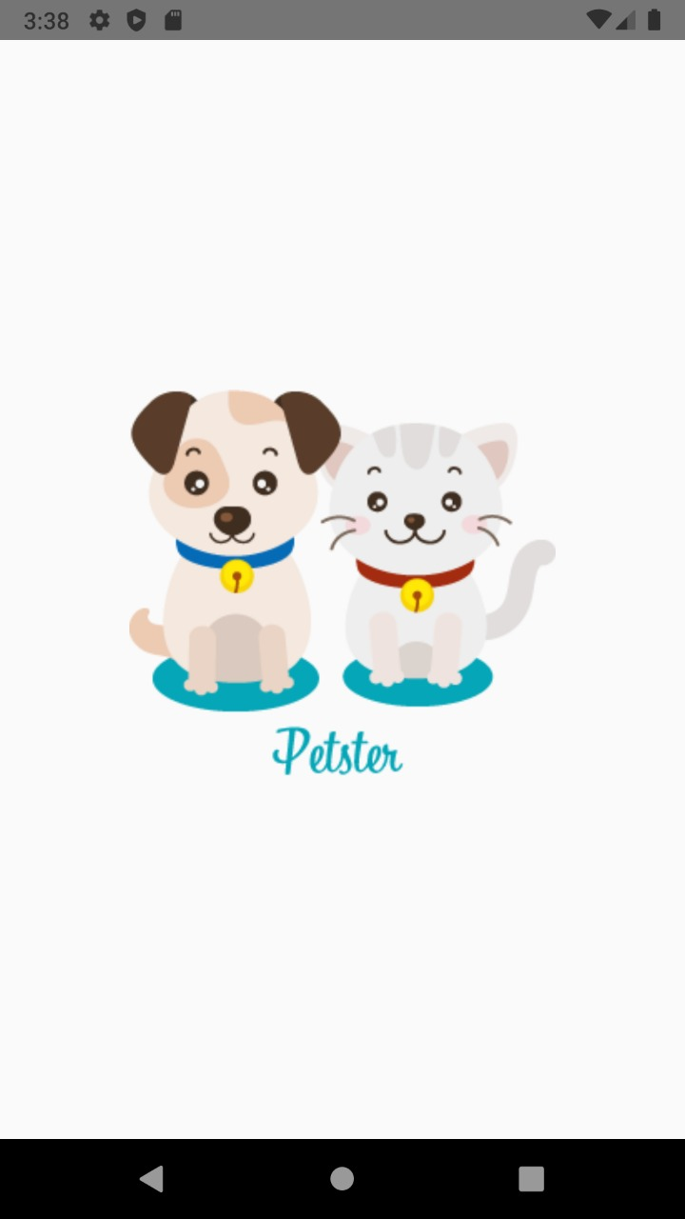
Splash Screen
A clean splash screen with a cute dog and a cat as our logo will ensure that mood of users will be uplifted immediately
A pause of 5 seconds on this splash screen and then user is navigated to Login Screen

Slide 6
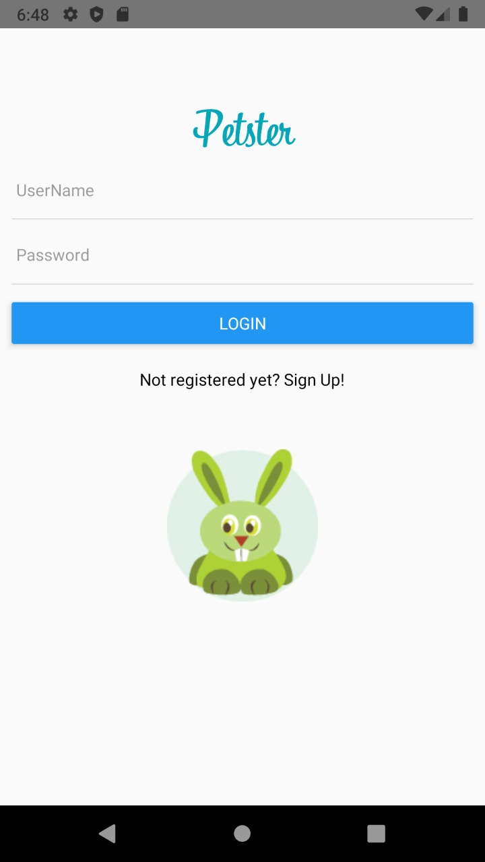
Login Screen
Login Screen will need only a username and a password (which is stored securely in our MongoDB database)
If Login button is tapped, a request is sent to server for authentication, depending on which an appropriate notification banner is shown
A correct login will navigate user to Home Screen
Incorrect login will show user a red notification banner and will remain on same screen
Tapping on Sign Up will take user to Registration Screen

Slide 7
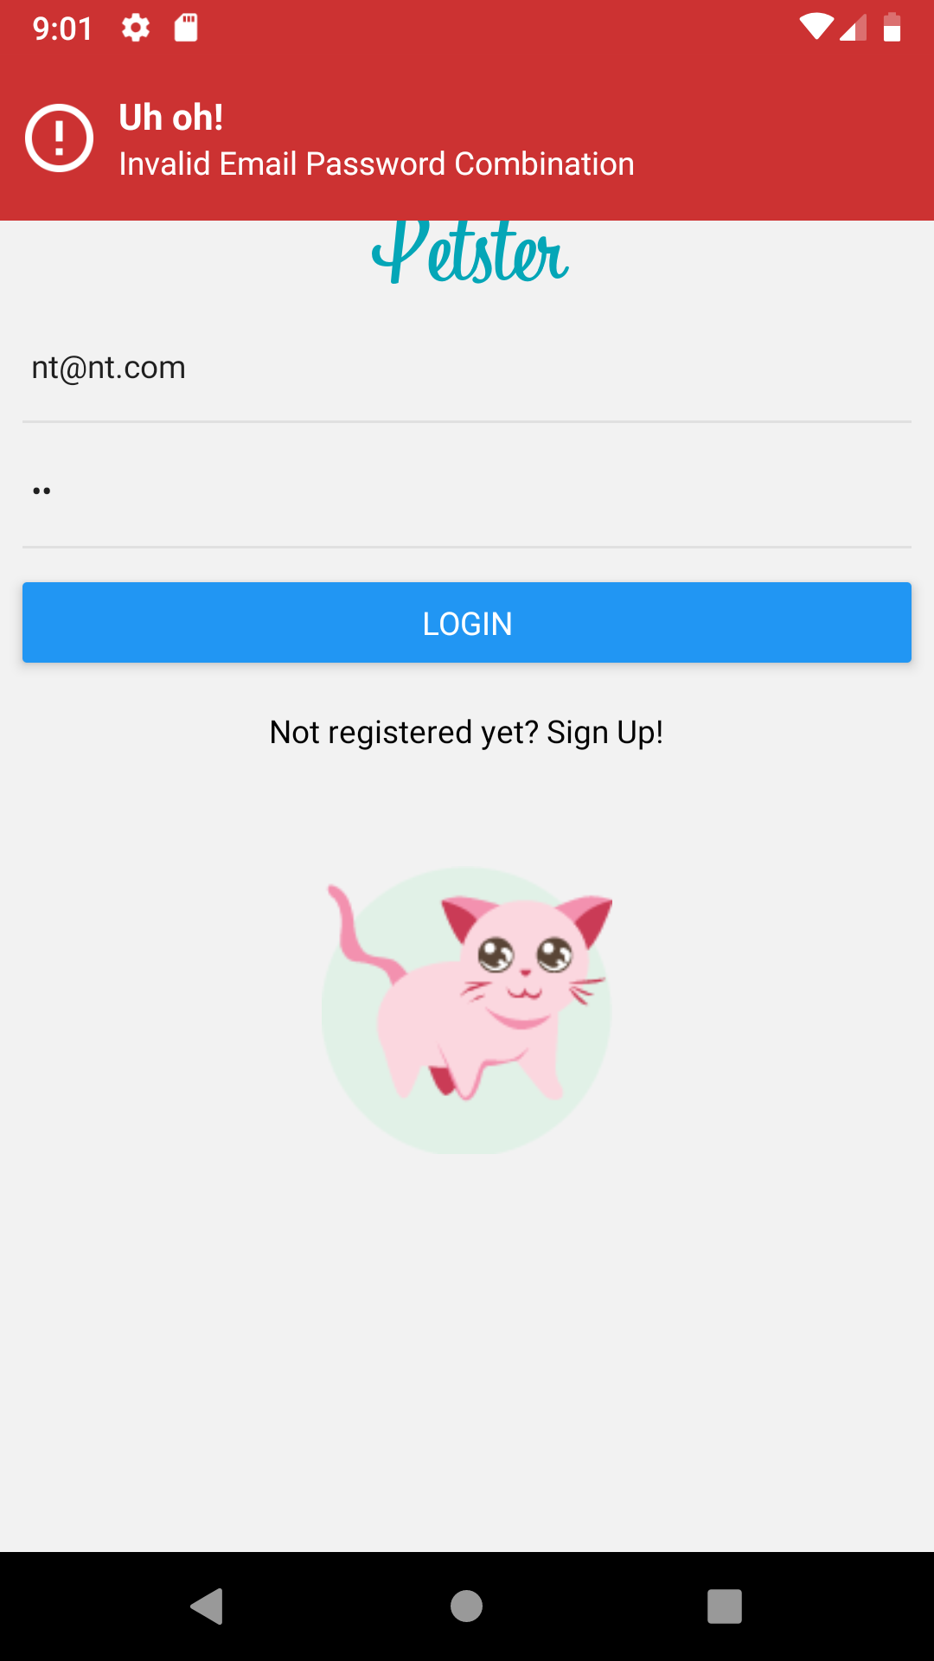
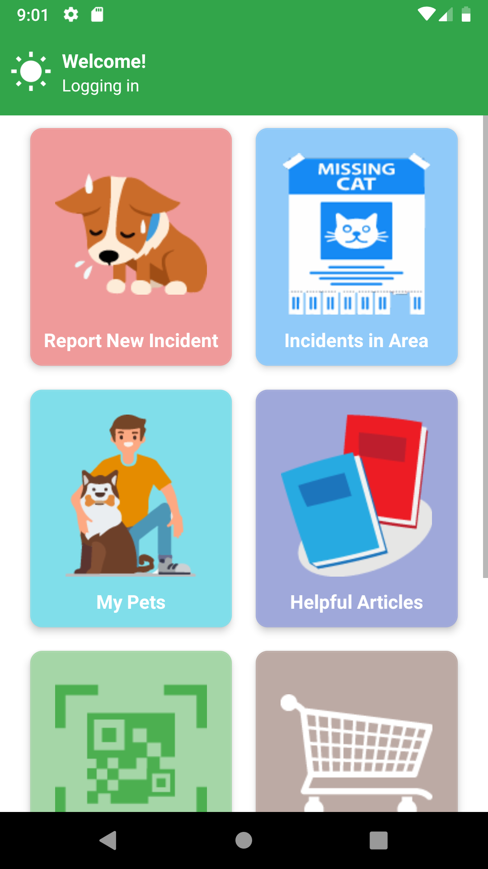
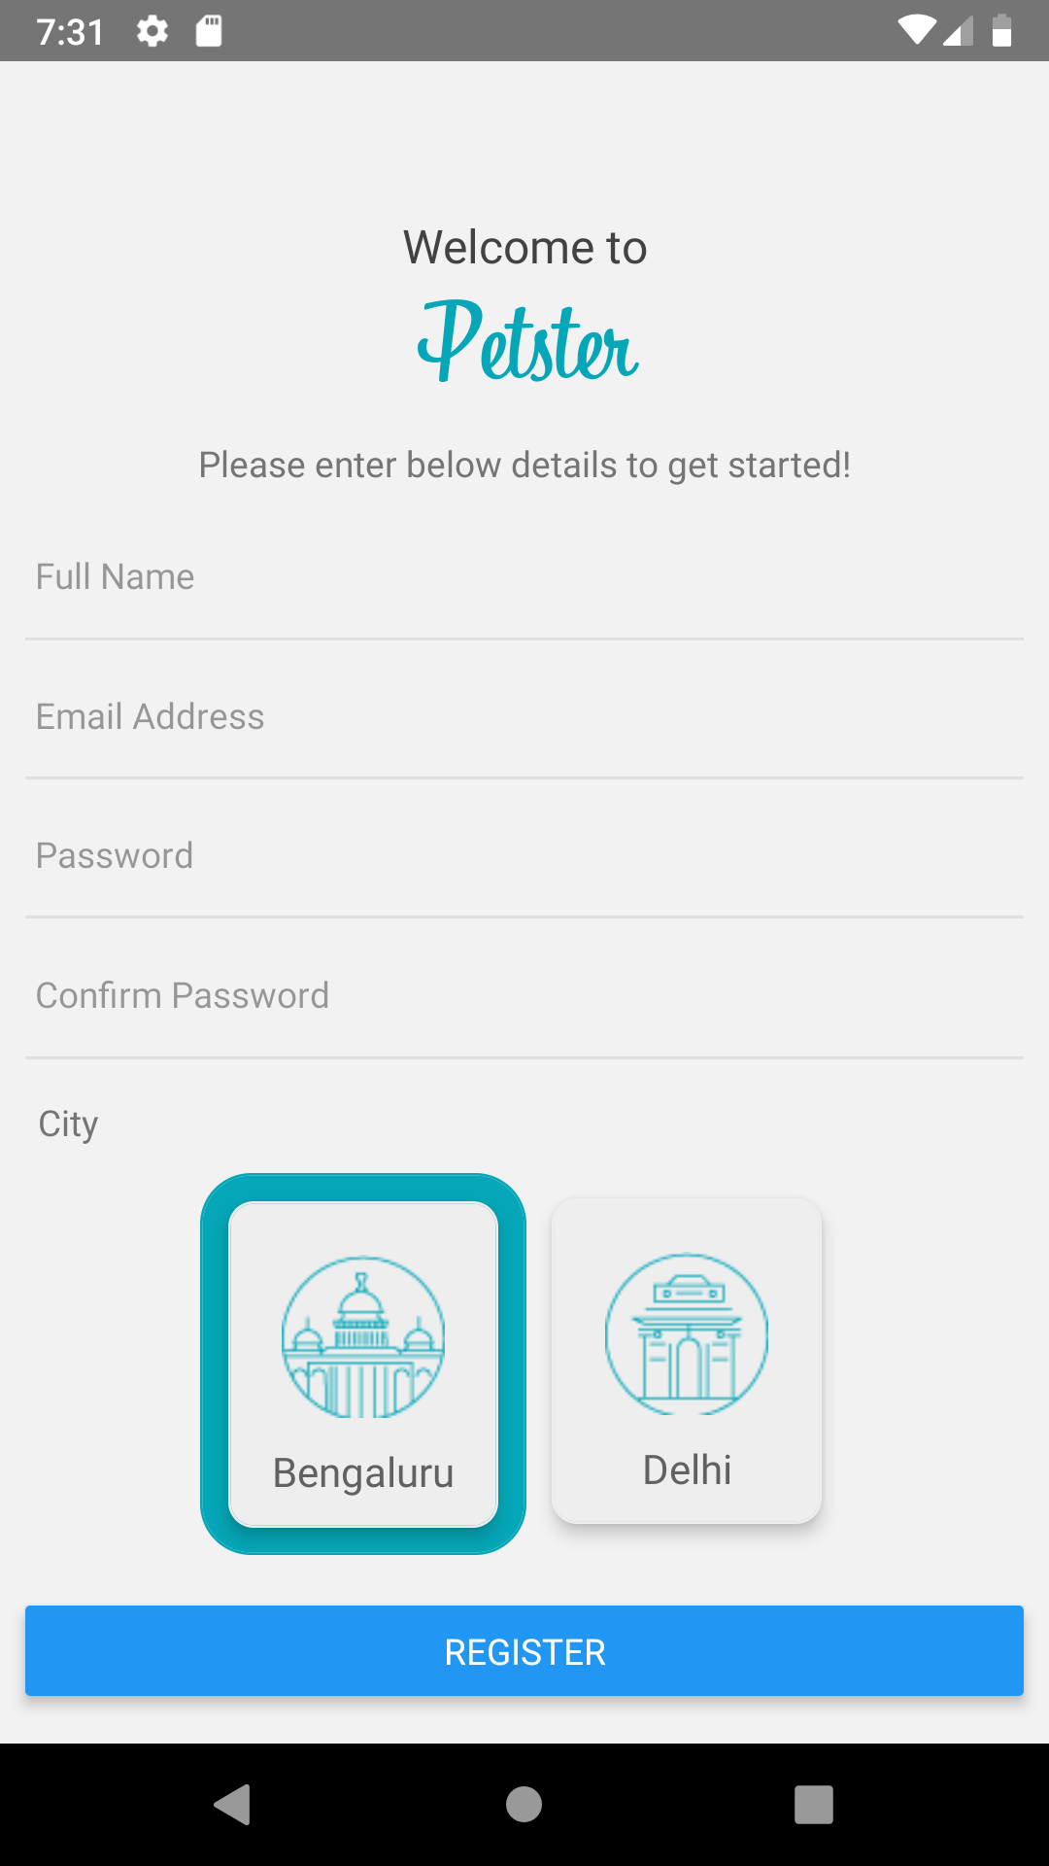
Navigations from Login Screen

Slide 8
Registration Screen
Users are required to submit a full name, email address, password and a city (currently listing Bengaluru and Delhi)
Once Register button is tapped, user details are sent securely to our remote server
Remote server then stores user details securely in database
User is then navigated to their Home Screen

Slide 9
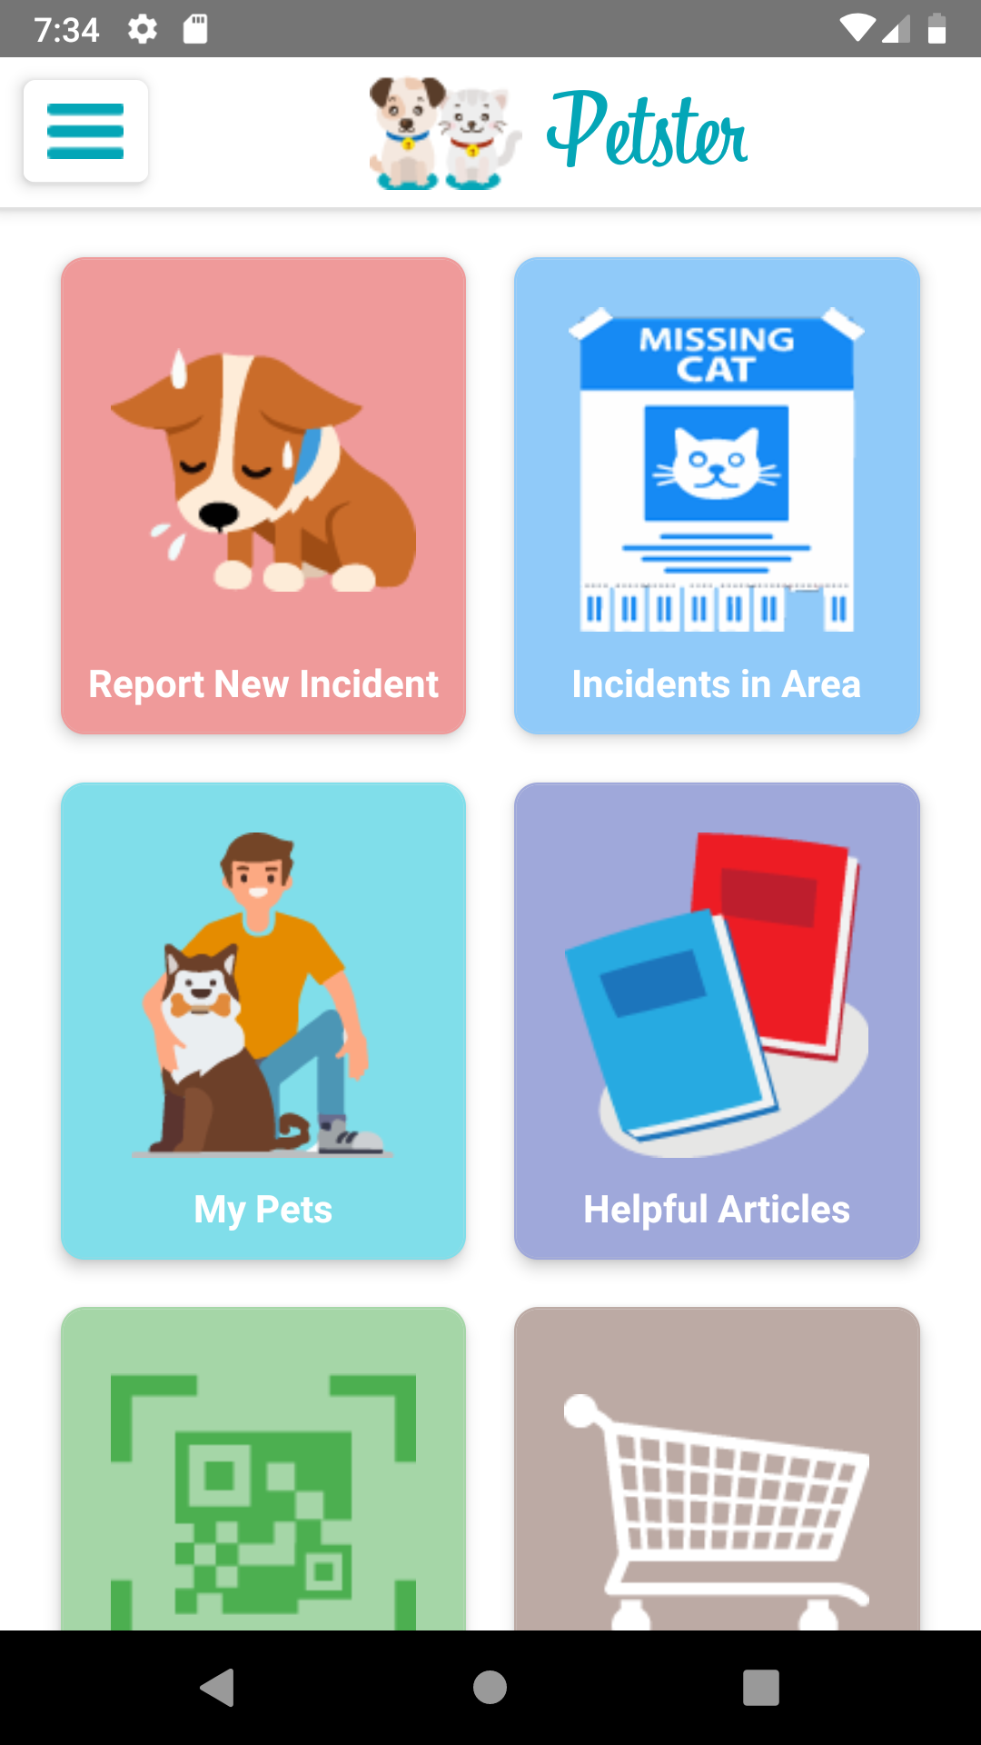
Home Screen
Report any incident immediately ( with camera support for uploading images) so that all registered users in vicinity could be notified
A list of unresolved reported incidents in the area
A list of your pets, with details for species, breed, special needs and their tag IDs
Blogs shared by experts to guide how to better take care of pets
Scan a Lost Pet’s tag
Order a newly adopted Pet’s tag

Slide 10
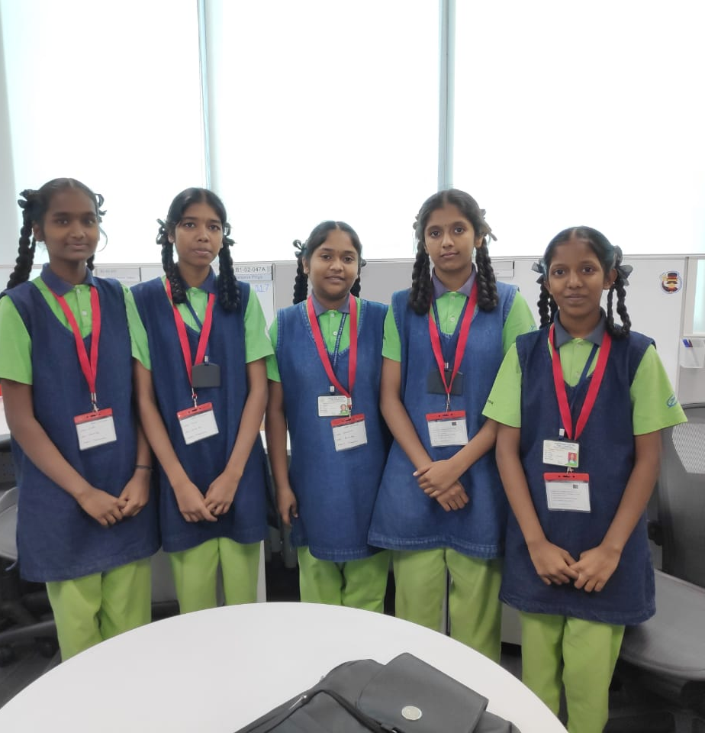
Thank you!
Students
Rakshitha
Jayashree
Sindhu
Chandana
Deepa
Mentors
Nishant Kumar Thakur
Sonam Raj
Rachitha KS
Sakshi Agarwal
Aditya Sharma

